Slide 1
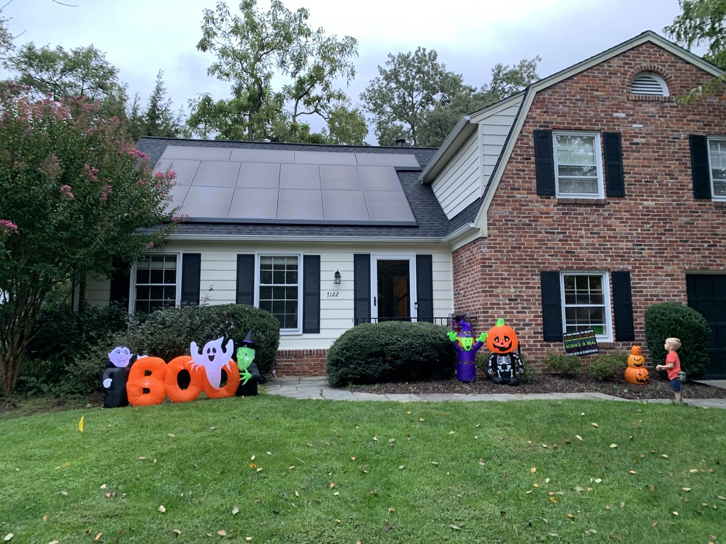
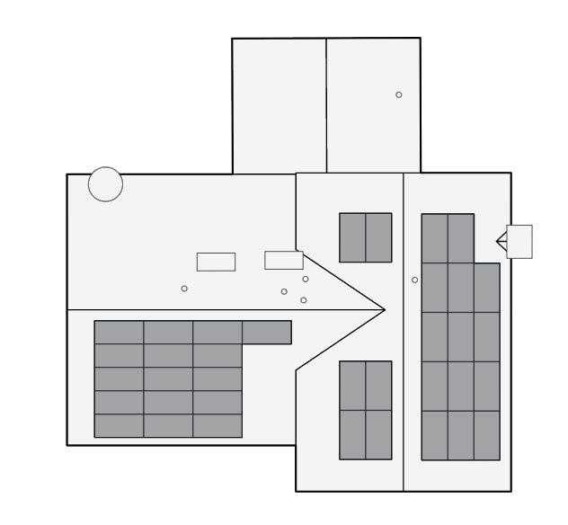
Tesla Solar

Slide 2
Our Motivation
Primary – Reducing use of non-sustainable energy, reducing reliance on overloaded power grid
Secondary – Expected cost savings, reducing our drain on overloaded grid
Timing Motivation – Leverage known tax savings that are expiring (more on that later)
Our friends got Tesla in 2020 and walked us through their experience with energy savings over the course of year

Slide 3
Cost of 12.24 kW system (36 panels)
$22.4K for panels
~$2.5K for main panel upgrade
5-year loan @ 0.99%
Your initial loan monthly payment assumes you plan on making extra payments with all tax credits. At 18 months, your monthly payment is recomputed. For us:
  $320/month if tax credits are applied to loan balance
  $480/month after month 18 if you keep the tax credits
System has a 25-year life, although panels degrade .5%/year

Slide 4
Tax Savings
Federal Solar Investment Tax Credit
  2022 – 26% of system cost ($6,565 for us)
  2023 – 22% of system cost (~$5500 – would have been $1K less for us)
  2024 – 0% unless new legislation extends it
Maryland Residential Clean Energy Rebate Program (R-CERP)
  $1,000 credit
  Unclear if this is going beyond 6/2022
Solar Renewable Energy Credits (SREC) – NOT APPLICABLE
  Tesla keeps these
Our total system cost - $17614 + loan interest (~$650) = ~$18.2K

Slide 5
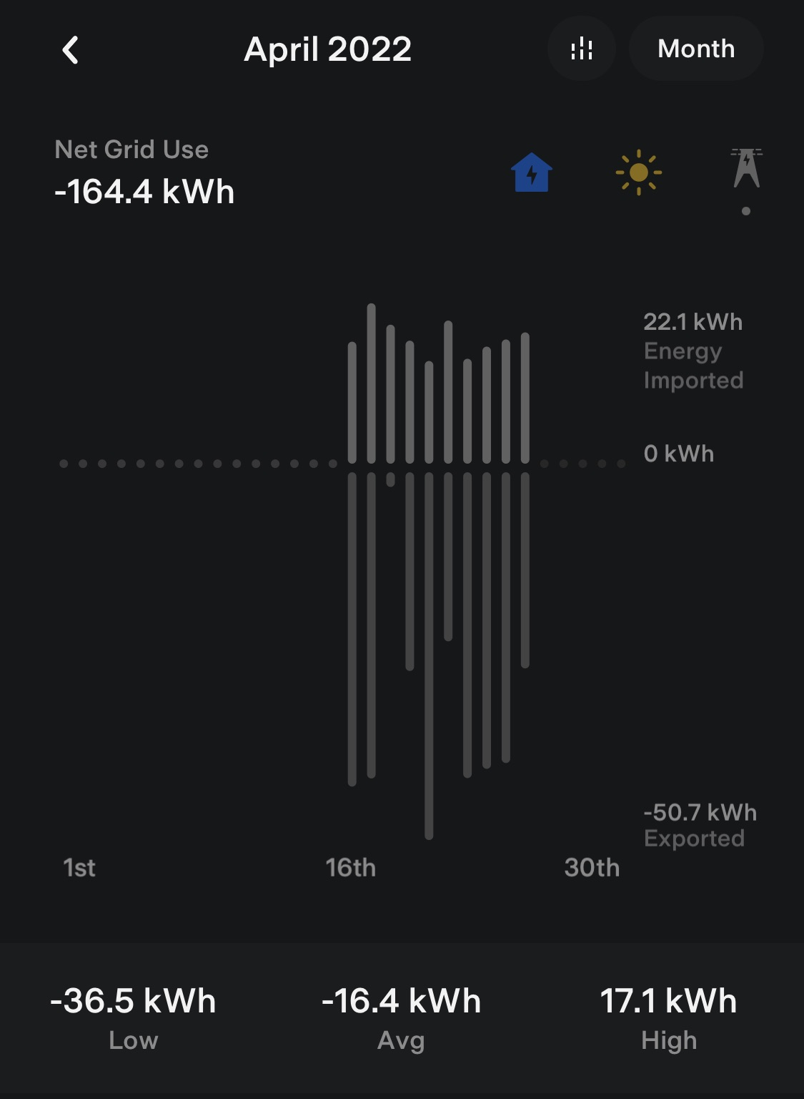
Cost Savings
“It is typical for your system to output 50% of its rated power at noon in the winter and 80% of its rated power at noon in the summer.” - Tesla
April – we generated more than we used (-16.4 kWh per day, we have exported 28.7 kWh more than we used)
Two big questions:
  Will Solar beat the A/C in the summer?
  Will Winter Sun support non-A/C use in Winter?

Slide 6
Cost Savings – Back-of-Envelope, 25 years
51,000 = $170/month avg electric bill
10,200 = If solar covers 80% of bill
18,200 = Cost of system
(orig energy cost) – (new energy cost) – (cost of system) = savings
51000 – 10200 – 18200 = $22,600 savings, or $1,883/yr
This simplified calculation is likely an overestimation of your potential savings.

Slide 7
Other Options - Powerwall, Solar Roof
Powerwall – Power batteries that store excess solar power for nighttime/power outages
  VERY expensive - $11K for first, $7K for each add’l (expect Tesla to rec’md 2)
  Unlikely to recoup through savings – primary benefits are power-outage protection, rarely ever touch power grid
  Will likely extend system installation timeline due to supply chain
Solar Roof – Roof tiles instead of mounted panels
  EXTREMELY expensive – 2-3 times cost of mounted panels
  Potentially less power (our estimate was about 1 kW less than panels)

Slide 8
Timeline
5/1/2021 – Ordered
5/5/2021 – Tesla Site Inspection
9/27/2021 – Power Panel Upgrade
10/4/2021 – Solar Panel Installation
2/22/2022 – Electric Meter Replacement
4/15/2022 – System On

Slide 9
Installation Concerns
Pandemic supply-chain shortages and contractor overload
  Solar panels, electric meter, main panel parts, all labor
Loan is non-transferable – if you sell your house, the loan must be paid in full
Roof replacement – best to do with a new roof, removal and installation will significantly eat into your savings

